Slide 1


Social Buzz Reactions Analysis

Slide 2


Today's agenda
Project recap
Problem
The Analytics team
Process
Insights
Summary

Slide 3

Social Buzz is a Social media & content creation company
It was established in 2010 and currently having 250 employees
Social Buzz keeps all users anonymous, and only track user reactions on every piece of content.
Social Buzz has reached over 500 million active users every month
They need the help of an advisory firm to oversee their scaling process effectively.
They need the following:
An audit of their big data practice
Recommendations for a successful IPO
An analysis of their content categories that highlights the top 5 categories with the largest aggregate popularity
Project Recap

Slide 4


An audit of their big data practice
Recommendations for a successful IPO
An analysis of their content categories that highlights the top 5 categories with the largest aggregate popularity
Problem

Slide 5



Andrew Fleming (Chief Technical Architect)
Marcus Rompton (Senior Principle)
Abimbola Giwa (Data Analyst)
The Analytics team

Slide 6
Process
1
Data study and evaluation
2
Data cleaning
3
Data visualization
4
Data analysis
5
Data insight

Slide 7
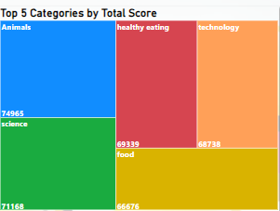

Insights
The top 5 categories include:
Animals, with a total score of 74,965
Science, with 71,168
Healthy eating, with 69,339
Technology, with 68,738
and Food, being the least, with 66,676

Slide 8
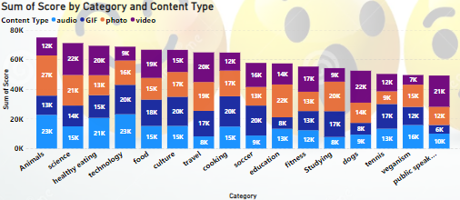
Photo and audio content types are more appealing to users,followed by video content type.
There are 16 unique categories in total.

Slide 9
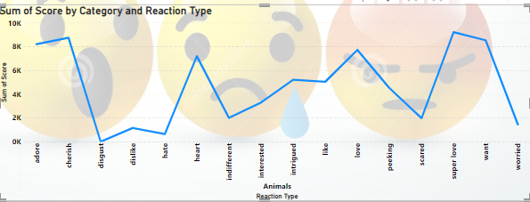

Animal, which is the highest category, has 15 reaction types.
Animal has 1897 reactions to posts

Slide 10
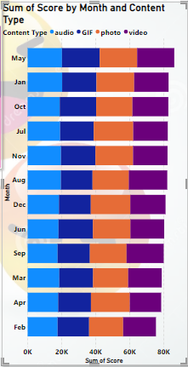
The month of May produced the most post.

Slide 11

Majority of the users have more interest in the top 5 categories, which are: Animal, Science, Healthy Eating, Technology and Food.
Most users are drawn and attracted to the photo and audio content types, so Social Buzz should push out more contents with these two content types.
I would also recommend video content type, as it still got some engagements
Summary

Slide 12

Thank you!
ANY QUESTIONS?

